Slide 1
About Lambda
Concept of lambda
Application with std::function<template> & etc..

Slide 2
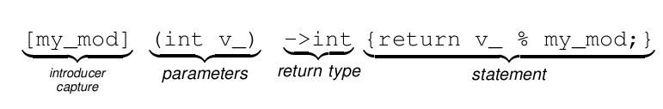
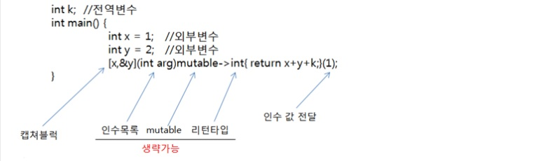
What is lambda? Source - http://thrillfighter.tistory.com/276 http://itguru.tistory.com/196

Slide 3
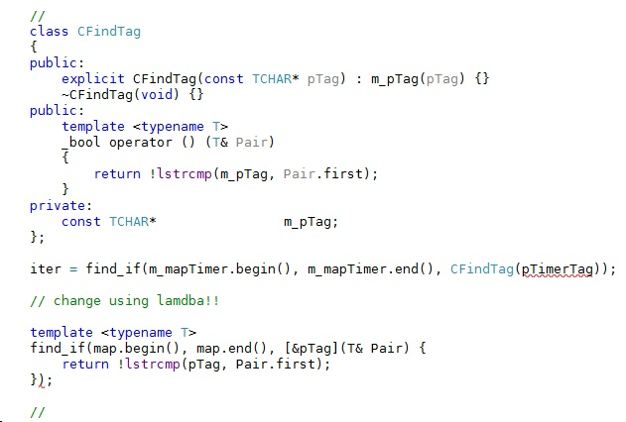
Support version
GCC : 4.5
MSVC (Visual studio) : 10.0 (VS 2010)
Clang : 3.1
EDG eccp : 4.1
Intel C++ : 11.0

Slide 4
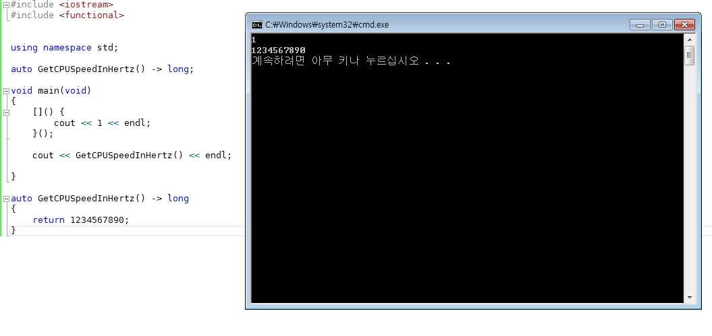
►Trailing Return Type

Slide 5
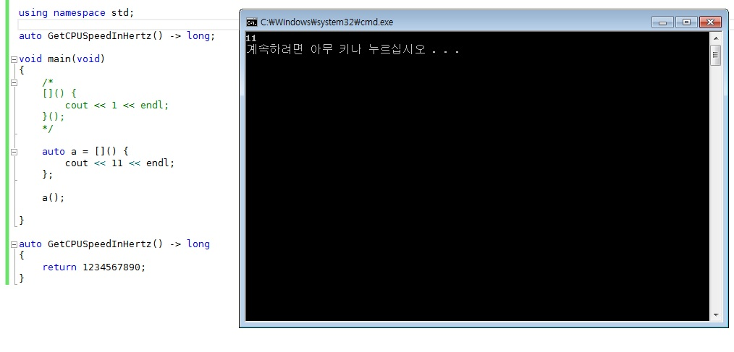

Slide 6
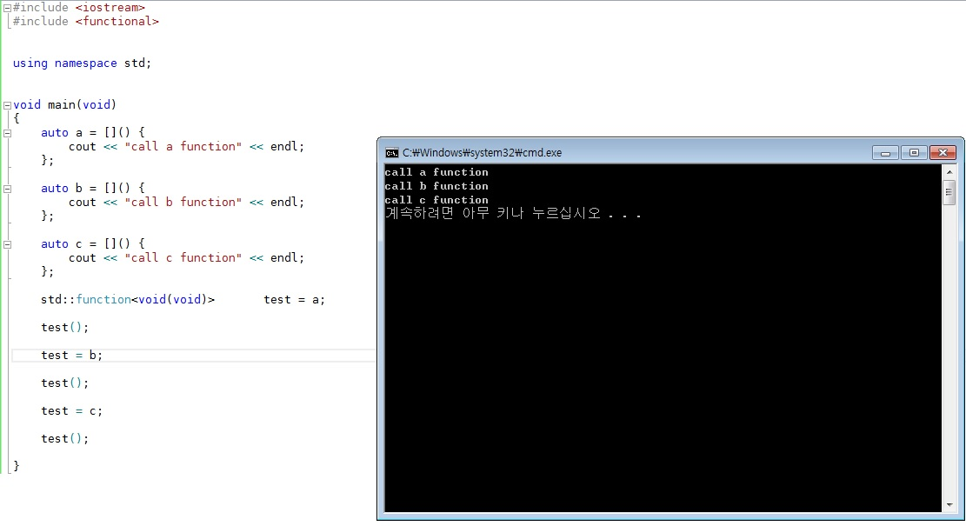

Slide 7
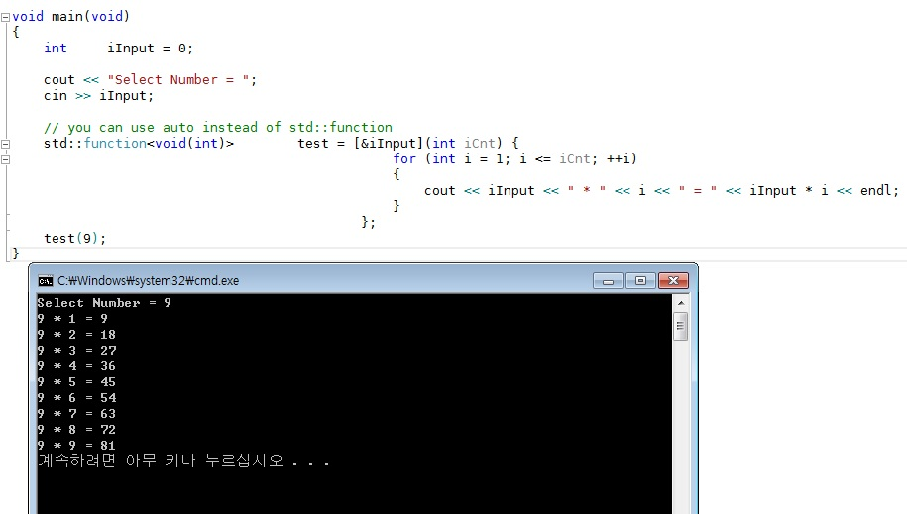

Slide 8
Why use Lambda?
For Ganzi?
Closure
High-Order-Function https://namu.wiki/w/%EA%B3%A0%EC%B0%A8%20%ED%95%A8%EC%88%98
Simple code & legibility
Callback Function
Dynamic binding

Slide 9
Weakness & Risk
- Heady….
- Hard to understand
- Limit of capture

